Slide 1
Unit 4
Sampling Techniques

Slide 2
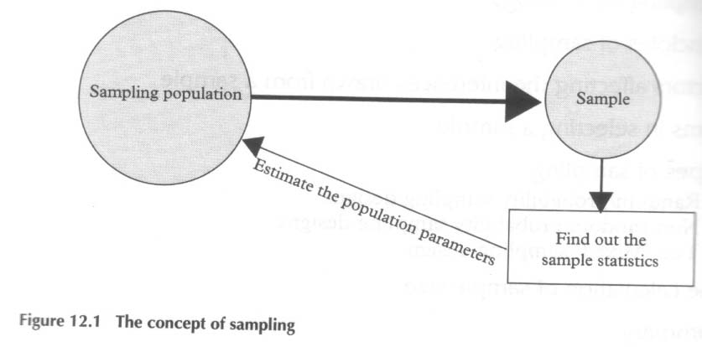
What is sampling?
The technique of selecting the units from the target UNIVERSE/POPULATION to obtain the desired sample size for studying the characteristics of the entire population is called sampling methods.

Slide 3
Difference between census vs. sample survey
Census Survey: Each and every unit of the population is studied and results are based on all units of the population.
Sample Survey: Only the selected number of units are studied and information obtained through these selected units are used to estimate the population parameters to make decision about the entire population.

Slide 4
Basic terms of Sampling
Universe/ population: is the totality of items or things under study.
Parameter: is a summary measures that describe the characteristics of an entire population.
For example Population: size (N), Mean (µ), Standard deviation (σ)
Sample: is the small portion of the population that is selected for the analysis of the population.
Statistics: is a summary measure of sample computed from sample data which is used to describe or estimate the characteristics of the entire population. For example Sample: size (n), Mean (x), Standard deviation (s)

Slide 5
What we try to do in sampling?
Religion | Population (%)
Hindu | 80.7
Buddhist | 10.7
Islam | 4.2
Christianity | 0.5
Kirat | 3.6
Caste/ Ethnicity (%) | Population (%)
Chhetri | 15.80
Bahun | 12.74
Magar | 7.14
Tharu | 6.75
Tamang | 5.64
Newar | 5.48
Age | Population (%)
20-29 | 33.9
30-39 | 24.7
40-49 | 17.4
50-59 | 11.9

Slide 6
Reasons for Sampling
Sampling can save budget.
Sampling can save time.
For given resources, sampling can broaden the scope of the data set.
Because the research process is sometimes destructive, the sample can save product.
If accessing the population is impossible; sampling is the only option.
Notes:
3

Slide 7
Reasons for Taking a Census
Eliminate the possibility that by chance a random sample may not be representative of the population.
For the safety of the consumer.
Notes:
4

Slide 8
Types of sampling
Probability sampling
Non-probability sampling
Simple random sampling
Systematic sampling
Stratified sampling
Cluster sampling
Convenience sampling
Judgment sampling
Quota sampling
Snowball sampling

Slide 9
Random Versus Nonrandom Sampling
Random sampling
Every unit of the population has the same probability of being included in the sample.
A chance mechanism is used in the selection process.
Eliminates bias in the selection process
Also known as probability sampling
Nonrandom Sampling
Every unit of the population does not have the same probability of being included in the sample.
Open to selection bias
Not appropriate data collection methods for most statistical methods
Also known as non-probability sampling
Notes:
6

Slide 10
Simple Random Sampling
Number each frame unit from 1 to N.
Use a random number table or a random number generator to select n distinct numbers between 1 and N, inclusively.
Easier to perform for small populations
Cumbersome for large populations
Notes:
8

Slide 11
Simple Random Sample: Numbered Population Frame
01 Alaska Airlines
02 Alcoa
03 Ashland
04 Bank of America
05 BellSouth
06 Chevron
07 Citigroup
08 Clorox
09 Delta Air Lines
10 Disney
11 DuPont
12 Exxon Mobil
13 General Dynamics
14 General Electric
15 General Mills
16 Halliburton
17 IBM
18 Kellog
19 KMart
20 Lowe’s
21 Lucent
22 Mattel
23 Mead
24 Microsoft
25 Occidental Petroleum
26 JCPenney
27 Procter & Gamble
28 Ryder
29 Sears
30 Time Warner
Notes:
9

Slide 12
Simple Random Sampling: Random Number Table
9
9
4
3
7
8
7
9
6
1
4
5
7
3
7
3
7
5
5
2
9
7
9
6
9
3
9
0
9
4
3
4
4
7
5
3
1
6
1
8
5
0
6
5
6
0
0
1
2
7
6
8
3
6
7
6
6
8
8
2
0
8
1
5
6
8
0
0
1
6
7
8
2
2
4
5
8
3
2
6
8
0
8
8
0
6
3
1
7
1
4
2
8
7
7
6
6
8
3
5
6
0
5
1
5
7
0
2
9
6
5
0
0
2
6
4
5
5
8
7
8
6
4
2
0
4
0
8
5
3
5
3
7
9
8
8
9
4
5
4
6
8
1
3
0
9
1
2
5
3
8
8
1
0
4
7
4
3
1
9
6
0
0
9
7
8
6
4
3
6
0
1
8
6
9
4
7
7
5
8
8
9
5
3
5
9
9
4
0
0
4
8
2
6
8
3
0
6
0
6
5
2
5
8
7
7
1
9
6
5
8
5
4
5
3
4
6
8
3
4
0
0
9
9
1
9
9
7
2
9
7
6
9
4
8
1
5
9
4
1
8
9
1
5
5
9
0
5
5
3
9
0
6
8
9
4
8
6
3
7
0
7
9
5
5
4
7
0
6
2
7
1
1
8
2
6
4
4
9
3
N = 30
n = 6
Notes:
10

Slide 13
Simple Random Sample: Sample Members
01 Alaska Airlines
02 Alcoa
03 Ashland
04 Bank of America
05 BellSouth
06 Chevron
07 Citigroup
08 Clorox
09 Delta Air Lines
10 Disney
11 DuPont
12 Exxon Mobil
13 General Dynamics
14 General Electric
15 General Mills
16 Halliburton
17 IBM
18 Kellog
19 KMart
20 Lowe’s
21 Lucent
22 Mattel
23 Mead
24 Microsoft
25 Occidental Petroleum
26 JCPenney
27 Procter & Gamble
28 Ryder
29 Sears
30 Time Warner
N = 30
n = 6
Notes:
11

Slide 14
Example of simple random sample:
Population:
Anil
Rita
Asmita
Shyam
Ram Krishna
Binu
Gopal
Dipak
Sangita
Chandrika
Sample size = 4
Random numbers are 2, 3, 8 and 5.
Sample:
Rita (Female)
Asmita (Female)
Dipak (Male)
Ram Krishna (Male)

Slide 15
Example of simple random sample:
Population:
Anil
Rita
Asmita
Shyam
Ram Krishna
Binu
Gopal
Dipak
Sangita
Chandrika
Sample size = 4
Random numbers are 2, 3, 6 and 9.
Sample:
Rita (Female)
Asmita (Female)
Binu (Female)
Sangita (Female)
No representation of male in the sample.

Slide 16
Example of simple random sample:
Population:
Anil
Rita
Asmita
Shyam
Ram Krishna
Binu
Gopal
Dipak
Sangita
Chandrika
Sample size = 4
Random numbers are 8, 5, 7 and 1.
Sample:
Dipak (Male)
Ram Krishna (Male)
Gopal (Male)
Anil (Male)
No representation of female in the sample.

Slide 17
Systematic Sampling
Convenient and relatively easy to administer
Population elements are an ordered sequence (at least, conceptually).
The first sample element is selected randomly from the first k population elements.
Thereafter, sample elements are selected at a constant interval, k, from the ordered sequence frame.
N
k
=
,
n
where
:
n
=
sample size
N
=
population size
k
=
size of selection interval
Notes:
14

Slide 18
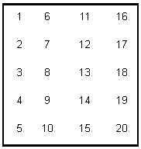
Example:
N = 20
n = 5
Interval = 20/5 = 4
Sample
2
6
10
14
18
Population:
Mr. Prakash
Ms. Sita
Mr. Ram Hari
Ms. Samjhana
Mr. Pasang
Ms. Gita
Mr. Khagendra
Ms. Rita Kumari
Mr. Rabindra
Ms. Sharada
N = 10
n = 5
Interval = 10/5 = 2
Sample:
Mr. Prakash
Mr. Ram Hari
Mr. Pasang
Mr. Khagendra
Mr. Rabindra
No representation
of women in
the sample.
Since the list in the population follows the certain
pattern, systematic sampling technique will be some time lead to biased sample.

Slide 19
Stratified Random Sample
Population is divided into non-overlapping subpopulations called strata.
A random sample is selected from each stratum.
Potential for reducing sampling error
Proportionate -- the percentage of the sample taken from each stratum is proportionate to the percentage that each stratum is within the population
Disproportionate -- proportions of the strata within the sample are different than the proportions of the strata within the population
Notes:
12

Slide 20
Stratification may be based on
gender (male/female)
rural area/urban area
geography
ethnicity
educational status
Types of business
political ideology (NC strongholds/UML strongholds) etc.
Population (heterogeneous)
Stratum (homogeneous)
Stratum (homogeneous)
The required number of elements is selected from each stratum using the SRS technique.

Slide 21
Example of stratified random sample:
Population (Tarai districts) Stratified based on DR:
Strata A: EDR
Jhapa
Morang
Sunsari
Saptari
Siraha
Strata B: CDR
Dhanusha
Mahottari
Sarlahi
Rautahat
Bara
Parsa
Chitawan
Strata C: WDR
Nawalparasi
Rupandehi
Kapilbastu
Sample size = 5
(1 from each of the strata)
Strata D: MWDR
1. Dang
2. Banke
3. Bardiya
Strata E: FWDR
1. Kailali
2. Kanchanpur
Random number for Strata A is 3.
Random number for Strata B is 6.
Random number for Strata C is 1.
Random number for Strata D is 2.
Random number for Strata E is 1.
Sample:
Sunsari (EDR)
Parsa (CDR)
Nawalparasi (WDR)
Banke (MWDR)
Kailali (FWDR)
Good representation of
population in the sample in
terms of development region.

Slide 22
Cluster Sampling
Population is divided into non-overlapping clusters or areas.
Each cluster is a miniature, or microcosm, of the population.
A subset of the clusters is selected randomly for the sample.
If the number of elements in the subset of clusters is larger than the desired value of n, these clusters may be subdivided to form a new set of clusters and subjected to a random selection process.
Notes:
16

Slide 23
Nonrandom Sampling
Convenience Sampling: sample elements are selected for the convenience of the researcher
Judgment Sampling: sample elements are selected by the judgment of the researcher
Quota Sampling: sample elements are selected until the quota controls are satisfied
Snowball Sampling: survey subjects are selected based on referral from other survey respondents
Notes:
19

Slide 24
Errors
Data from nonrandom samples are not appropriate for analysis by inferential statistical methods.
Sampling Error occurs when the sample is not representative of the population.
Non-sampling Errors
Missing Data, Recording, Data Entry, and Analysis Errors
Poorly conceived concepts , unclear definitions, and defective questionnaires
Response errors occur when people so not know, will not say, or overstate in their answers
Notes:
20

Slide 25
Application of Sampling design
Sampling design of NLSS II (2003/04)
Stratification of the country in NLSS II survey
Mountains
Kathmandu valley urban area
Other urban areas in hills
Rural hills
Urban Tarai
Rural Tarai
25

Slide 26
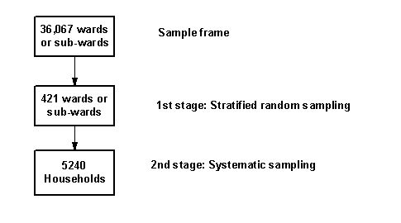

Slide 27
Stratification of the country in Voter-to-List survey
Rural mountains
Urban mountains and hills
Kathmandu Valley urban area
Rural hills EA
Rural hills CE
Rural hills WE
Rural hills MW
Rural hills FW
Urban Tarai
Rural Tarai EA
Rural Tarai CE
Rural Tarai WE
Rural Tarai MW
Rural Tarai FW

Slide 28
Sampling Distribution of
x
Proper analysis and interpretation of a sample statistic requires knowledge of its distribution.
Process of
Inferential Statistics
Notes:
21

Slide 29
Distribution of a Small Finite Population
N = 8
54, 55, 59, 63, 68, 69, 70
Population Histogram
3
2
Frequency
1
0
52.5
57.5
62.5
67.5
72.5

Slide 30
Sample Space for n = 2 with Replacement
Sample
Mean
Sample
Mean
Sample
Mean
Sample
Mean
1
(54,54)
54.0
17
(59,54)
56.5
33
(64,54)
59.0
49
(69,54)
61.5
2
(54,55)
54.5
18
(59,55)
57.0
34
(64,55)
59.5
50
(69,55)
62.0
3
(54,59)
56.5
19
(59,59)
59.0
35
(64,59)
61.5
51
(69,59)
64.0
4
(54,63)
58.5
20
(59,63)
61.0
36
(64,63)
63.5
52
(69,63)
66.0
5
(54,64)
59.0
21
(59,64)
61.5
37
(64,64)
64.0
53
(69,64)
66.5
6
(54,68)
61.0
22
(59,68)
63.5
38
(64,68)
66.0
54
(69,68)
68.5
7
(54,69)
61.5
23
(59,69)
64.0
39
(64,69)
66.5
55
(69,69)
69.0
8
(54,70)
62.0
24
(59,70)
64.5
40
(64,70)
67.0
56
(69,70)
69.5
9
(55,54)
54.5
25
(63,54)
58.5
41
(68,54)
61.0
57
(70,54)
62.0
10
(55,55)
55.0
26
(63,55)
59.0
42
(68,55)
61.5
58
(70,55)
62.5
11
(55,59)
57.0
27
(63,59)
61.0
43
(68,59)
63.5
59
(70,59)
64.5
12
(55,63)
59.0
28
(63,63)
63.0
44
(68,63)
65.5
60
(70,63)
66.5
13
(55,64)
59.5
29
(63,64)
63.5
45
(68,64)
66.0
61
(70,64)
67.0
14
(55,68)
61.5
30
(63,68)
65.5
46
(68,68)
68.0
62
(70,68)
69.0
15
(55,69)
62.0
31
(63,69)
66.0
47
(68,69)
68.5
63
(70,69)
69.5
16
(55,70)
62.5
32
(63,70)
66.5
48
(68,70)
69.0
64
(70,70)
70.0

Slide 31
Distribution of the Sample Means
Sampling Distribution Histogram
20
15
10
Frequency
5
0
53.75
56.25
58.75
61.25
63.75
66.25
68.75
71.25

Slide 32
1,800 Randomly Selected Values from an Exponential Distribution
F
r
e
q
u
e
n
c
y
450
400
350
300
250
200
150
100
50
0
0
.5
1
1.5
2
2.5
3
3.5
4
4.5
5
5.5
6
6.5
7
7.5
8
8.5
9
9.5
10
X
Notes:
25

Slide 33
Means of 60 Samples (n = 2) from an Exponential Distribution
F
r
e
q
u
e
n
c
y
9
8
7
6
5
4
3
2
1
0
0.00
0.25
0.50
0.75
1.00
1.25
1.50
1.75
2.00
2.25
2.50
2.75
3.00
3.25
3.50
3.75
4.00
x
Notes:
26

Slide 34
Means of 60 Samples (n = 5) from an Exponential Distribution
F
r
e
q
u
e
n
c
y
10
9
8
7
6
5
4
3
2
1
0
0.00
0.25
0.50
0.75
1.00
1.25
1.50
1.75
2.00
2.25
2.50
2.75
3.00
3.25
3.50
3.75
4.00
x
Notes:
27

Slide 35
Means of 60 Samples (n = 30) from an Exponential Distribution
16
F
r
e
q
u
e
n
c
y
14
12
10
8
6
4
2
0
0.00
0.25
0.50
0.75
1.00
1.25
1.50
1.75
2.00
2.25
2.50
2.75
3.00
x
Notes:
28

Slide 36
1,800 Randomly Selected Values from a Uniform Distribution
F
r
e
q
u
e
n
c
y
250
200
150
100
50
0
0.0
0.5
1.0
1.5
2.0
2.5
3.0
3.5
4.0
4.5
5.0
X
Notes:
29

Slide 37
Means of 60 Samples (n = 2) from a Uniform Distribution
F
r
e
q
u
e
n
c
y
10
9
8
7
6
5
4
3
2
1
0
1.00
1.25
1.50
1.75
2.00
2.25
2.50
2.75
3.00
3.25
3.50
3.75
4.00
4.25
x
Notes:
30

Slide 38
Means of 60 Samples (n = 5) from a Uniform Distribution
F
r
e
q
u
e
n
c
y
12
10
8
6
4
2
0
1.00
1.25
1.50
1.75
2.00
2.25
2.50
2.75
3.00
3.25
3.50
3.75
4.00
4.25
x
Notes:
31

Slide 39
Means of 60 Samples (n = 30) from a Uniform Distribution
F
r
e
q
u
e
n
c
y
25
20
15
10
5
0
1.00
1.25
1.50
1.75
2.00
2.25
2.50
2.75
3.00
3.25
3.50
3.75
4.00
4.25
x
Notes:
32

Slide 40
Central Limit Theorem
For sufficiently large sample sizes (n ≥ 30),
The distribution of sample means , is approximately normal;
The mean of this distribution is equal to μ, the population mean; and
Its standard deviation is ,
Regardless of the shape of the population distribution.
x
σ
n
Notes:
33

Slide 41
Central Limit Theorem
Notes:
34

Slide 42
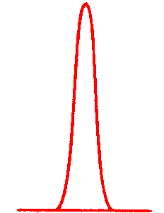
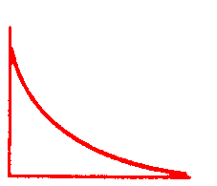
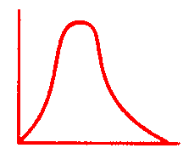
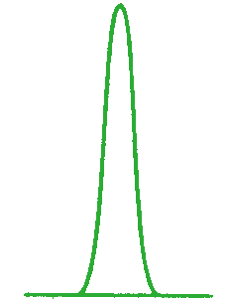
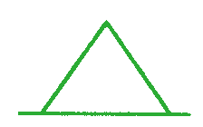
Distribution of Sample Means for Various Sample Sizes
Exponential
Population
n = 2
n = 5
n = 30
Uniform
Population
n = 2
n = 5
n = 30
Notes:
36

Slide 43
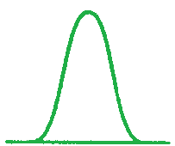
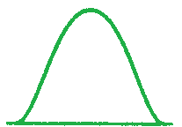
Distribution of Sample Means for Various Sample Sizes
Normal
Population
n = 2
n = 5
n = 30
Notes:
37

